Slide 1
Causes of the Great Depression
Over Production
Unequal Distribution of Wealth
Industry
Agriculture
Stock Market Crash and Financial Panic
Monetary Policy
High Tariffs & War Debts

Slide 2
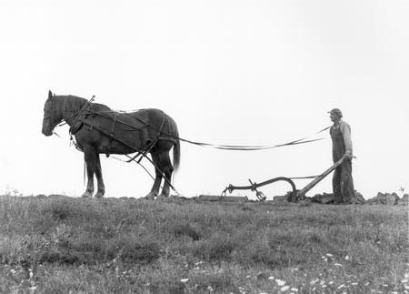
Causes of the Great Depression
Farm Depression of the 1920s
Prices of farm products fell about 40% by 1921 and remained low through the 1920s
Farmers were producing more than American consumers were consuming
Some farmers lost so much money they couldn’t pay the mortgage on their farm
Farmers had to rent the land or move

Slide 3
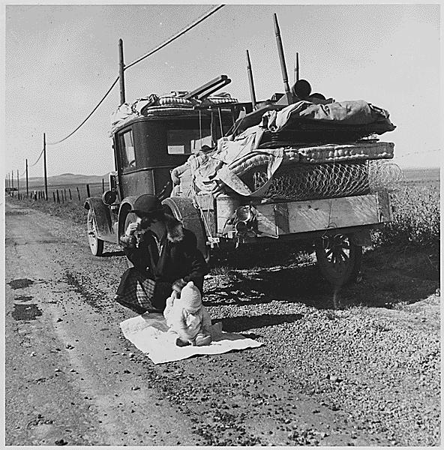
Causes of the Great Depression
Farm Depression of the 1920s
Prices of farm products fell about 40% by 1921 and remained low through the 1920s
Farmers were producing more than American consumers were consuming
Some farmers lost so much money they couldn’t pay the mortgage on their farm
Farmers had to rent the land or move

Slide 4
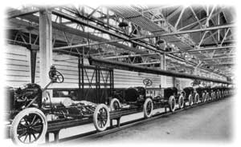
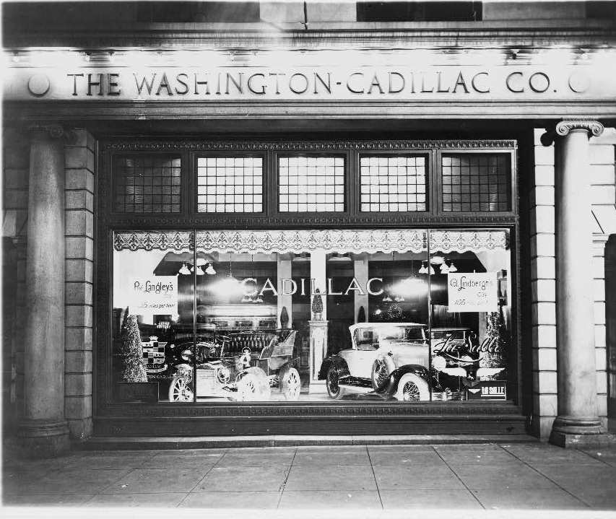
Causes of the Great Depression
Overproduction in Industry
Factories were producing products, however wages for workers were not rising enough for them to buy the goods
Too few workers could afford to buy the factory output
The surplus products could not be sold overseas due to high tariffs and lack of money in Europe

Slide 5
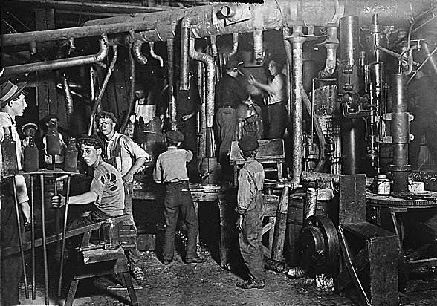
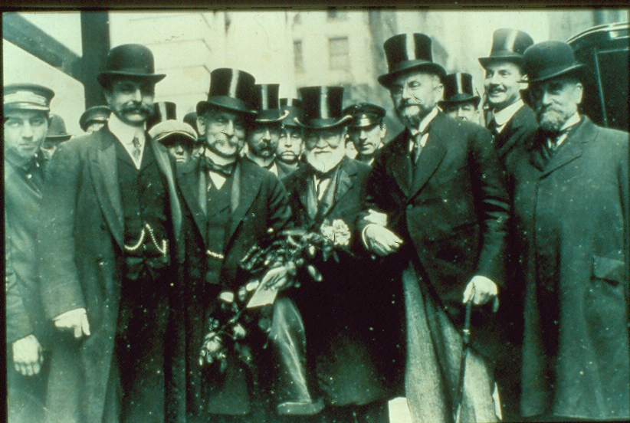
Causes of the Great Depression
Uneven Distribution of Income
Industrial productions increased about 50% but the wages of the industrial workers rose far more slowly
As a result, these workers couldn’t buy goods as fast as industry produced them

Slide 6
99% of the population received a 9% increase in their income, while the top 1% saw their income rise by 75%.
1,230,000 Americans
121,770,000 Americans

Slide 7
Causes of the Great Depression
High Tariffs and War Debts
European nations owed $10 billion ($115 billion in current dollars) to the U.S. in reparations
Their economies were devastated and had no way of paying the money back
U.S. insisted on repayment.
This forced the allies to demand Germany pay reparations imposed by Treaty of Versailles
Europe could no longer purchase goods from the U.S.
1922, U.S. passed the Hawley-Smoot Act
Instituted high tariffs on industrial products
Other nations retaliated and world trade declined

Slide 8
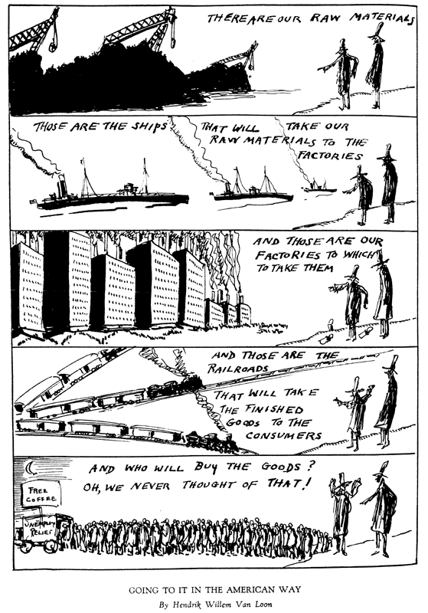

Slide 9
How did $30,000,000,000 evaporate?

Slide 10
Speculation
Investors would buy stock that they thought would quickly rise in value, once the price went as high as the investor thought it would go they sold.

Slide 11
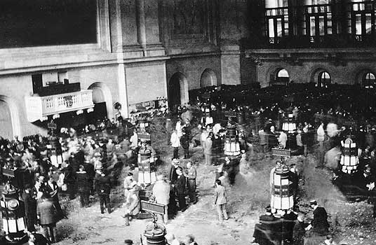
Buying on Margin
Investors only had to put 5% of the stock value down; the stockbroker loaned the money they didn’t have

Slide 12
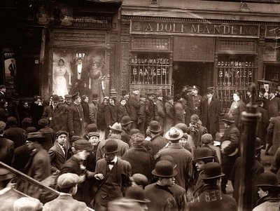
Banks
Banks loaned stock brokers money for the margin loans, they used the savings people had deposited in the bank for these loans.
The savings was not insured.

Slide 13
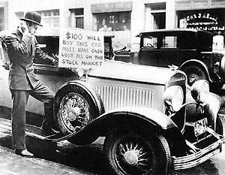
The Crash
By August 1929, 6 billion loaned out
Some investors realize market is saturated
Investors begin to sell stock, causing prices to drop
As prices drop, brokers call in their loans
Investors do not have the cash to payoff the loans
Brokers enforce sales of stock to payoff the loans
Prices drop more, causing panic sales of stock
Prices drop dramatically and money evaporates into thin air

